Slide 8
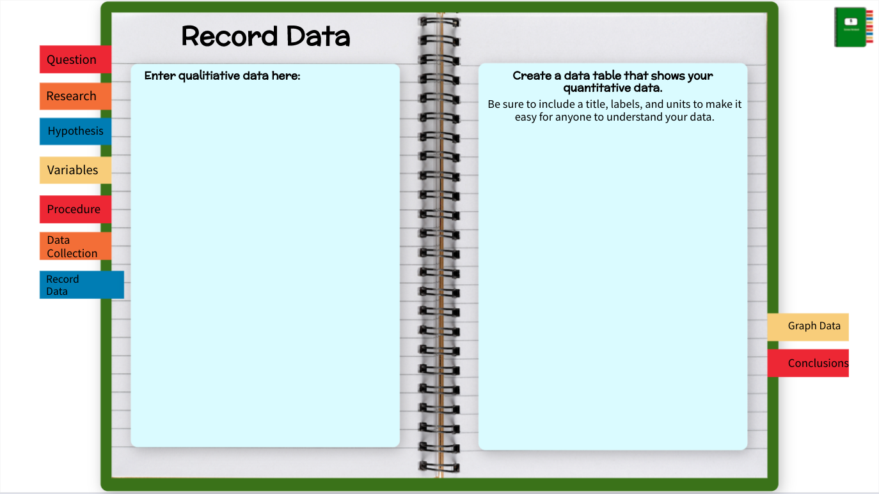
Enter Data Table Title Here
 | Trial 1 | Trial 2 | Trial 3 | Average

Slide 9
Select here open a Create a Graph website in a new tab.
Take a screenshot,
and then insert it here.
Click here for more examples of line graphs.
Click here for more examples of bar graphs.

Slide 11
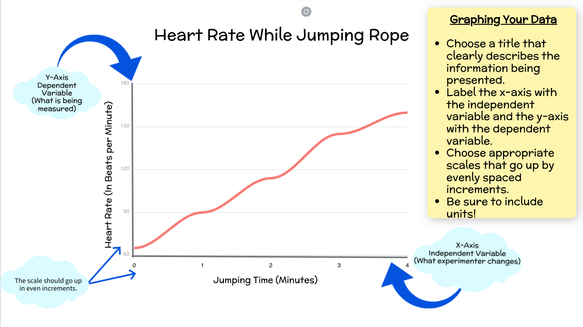
Back

Slide 12
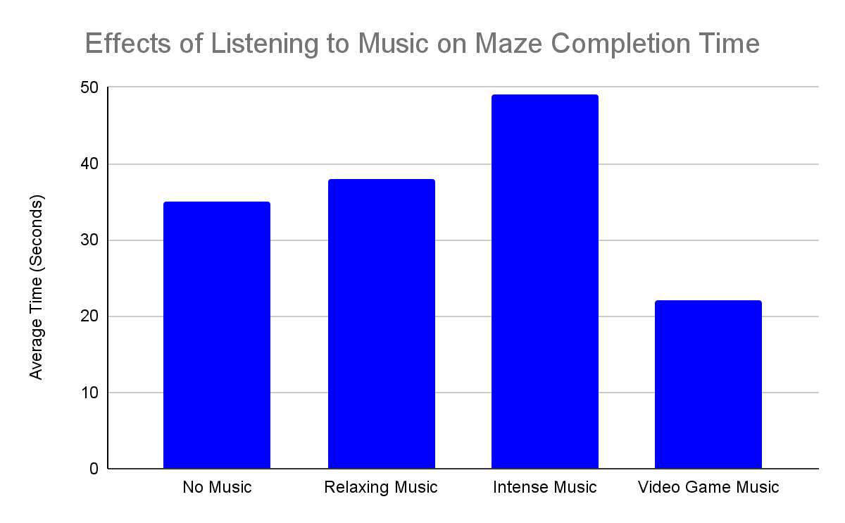
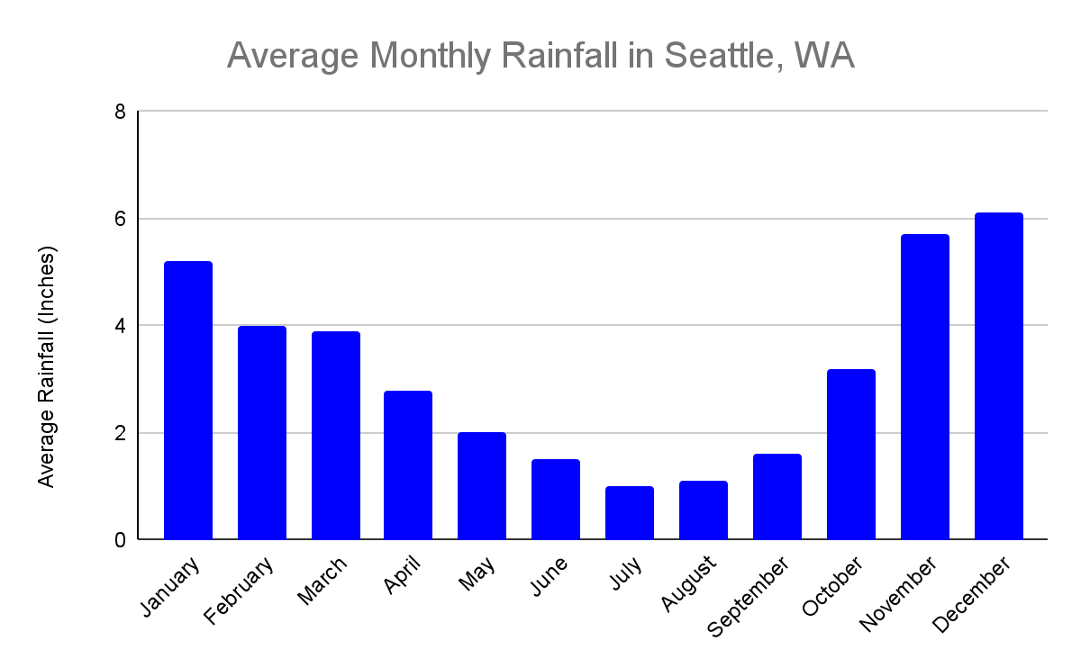
Back
A bar graph is used to compare different groups or track larger changes over time.

Slide 13
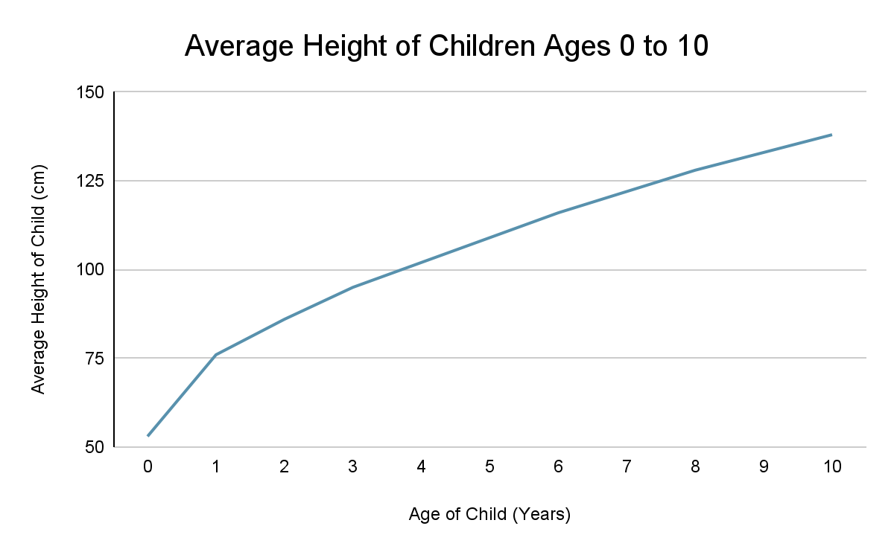
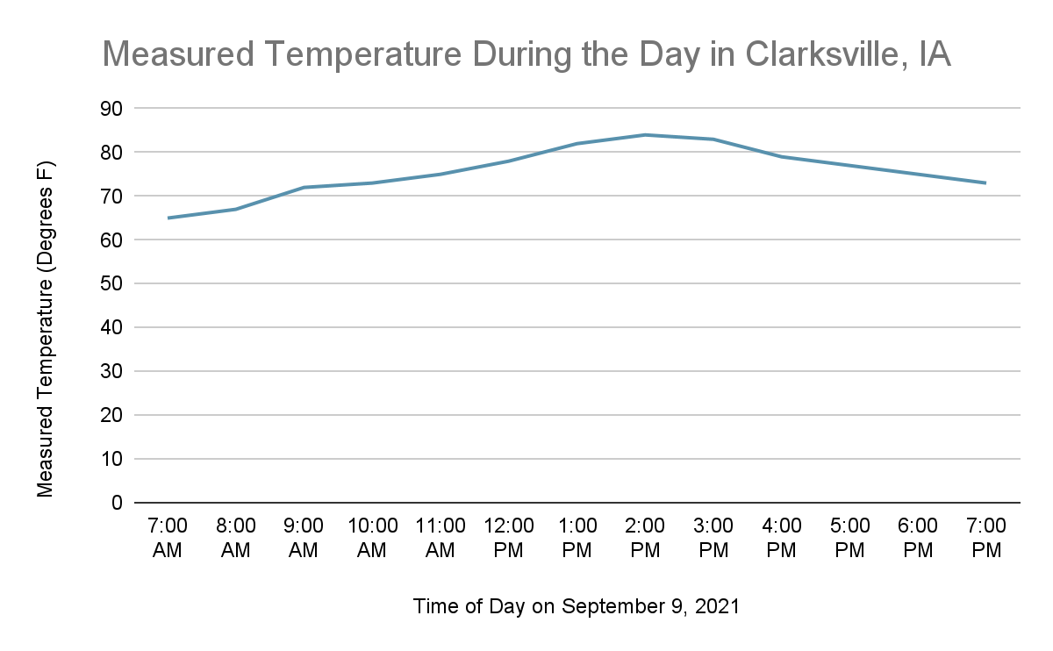
Back
A line graph is used to show small changes over time.

